Slide 1
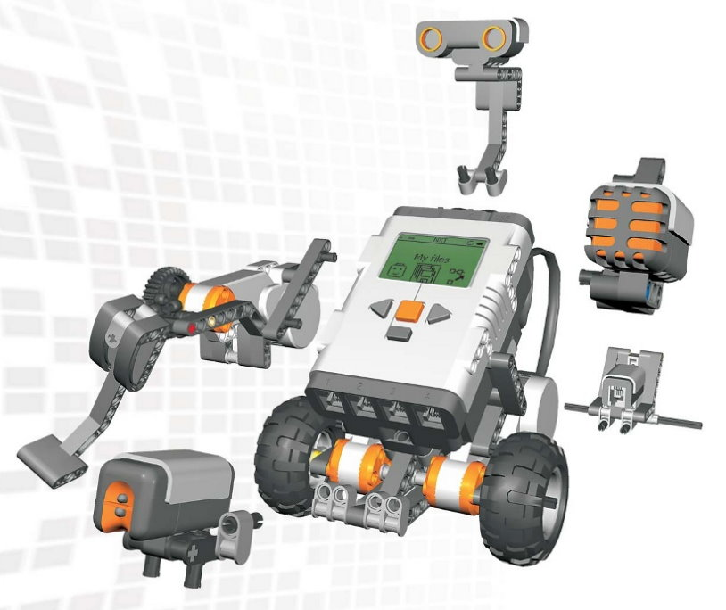
Welcome to LEGO Mindstorms NXT!
Let's explore the amazing world of building and programming robots with LEGO!

Slide 2
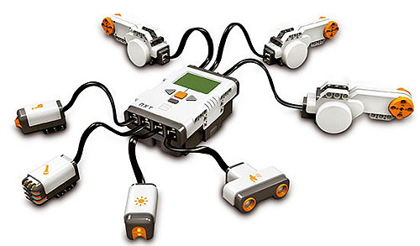
What is LEGO Mindstorms NXT?
It's a robotics kit that lets you build, program, and control robots using LEGO bricks, motors, and sensors.

Slide 3
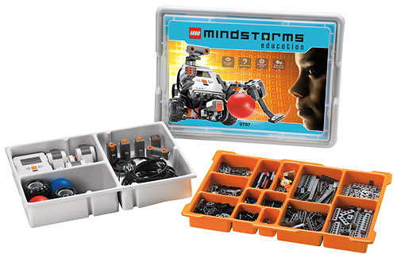
Meet the NXT 9797 Kit
This kit includes special LEGO parts like motors, sensors, and the NXT brick to help build cool robots.

Slide 4
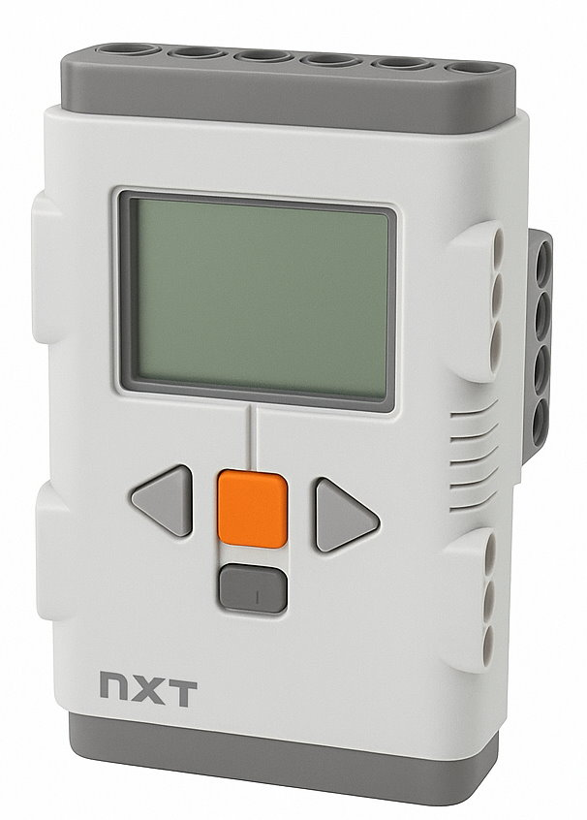
The NXT Brick
The "Brain" of the robot
It runs programs
Connects to motors & sensors
Has a display and buttons

Slide 5
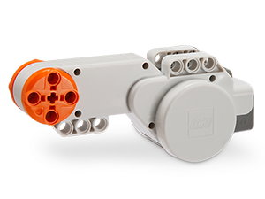
Motors
These are used to make your robot move! You can attach them to wheels or arms.

Slide 6
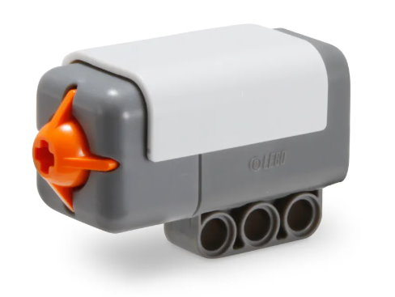
Touch Sensor
This sensor detects when it’s pressed. Great for bumpers or triggers!

Slide 7
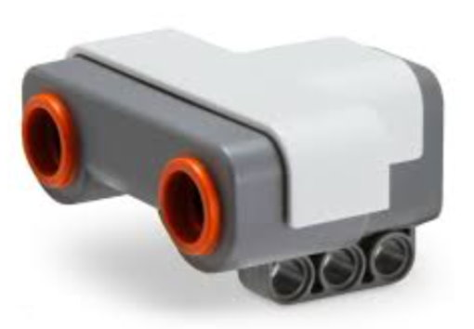
Ultrasonic Sensor
It uses sound waves to measure distance, like how bats see!

Slide 8
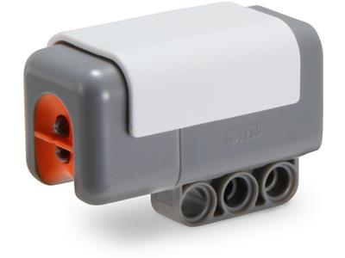
Light Sensor
It detects light and dark colors. Useful for following lines.

Slide 9
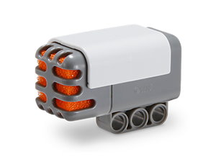
Sound Sensor
It measures loudness. Your robot can react to claps or voices!

Slide 10
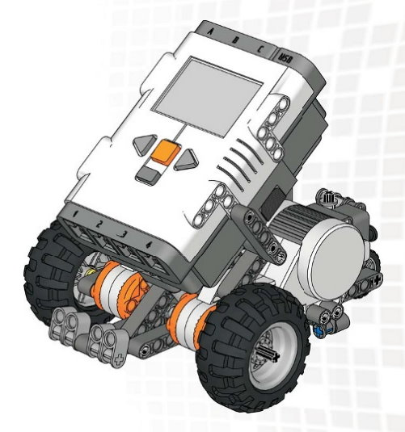
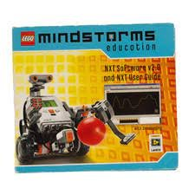
Building Your Robot
Use instructions in the kit, or videos, to design your own robot using LEGO pieces and sensors.

Slide 11
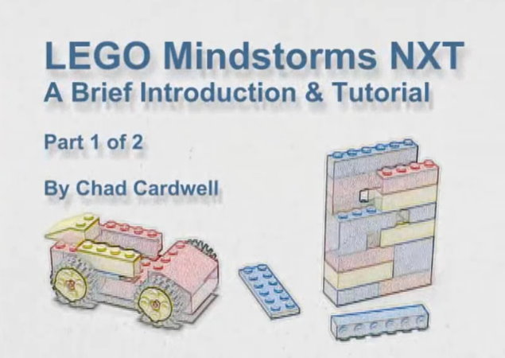
Creating Your First Program
In the Chad Cardwell’s Tutorial Video Part 1, you will see how to build a simple robot using:
The Brick
Motors
The Sound
& Ultrasonic
sensors

Slide 12
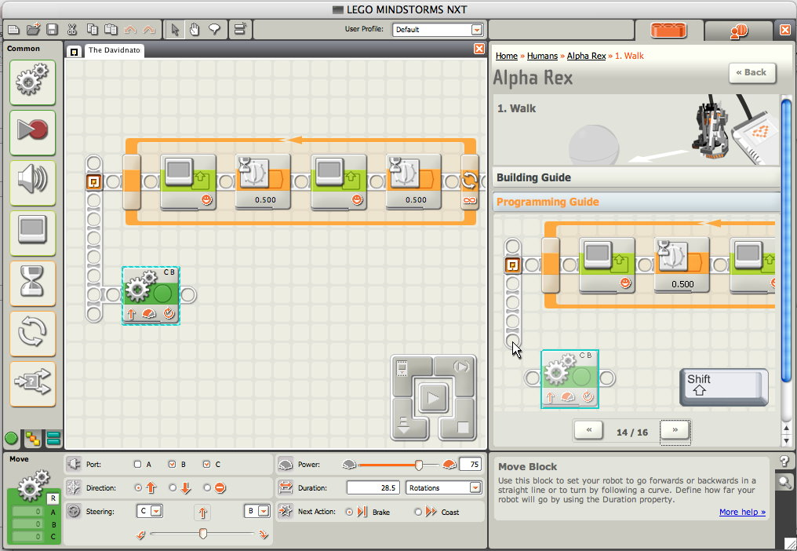
Introduction to NXT Software
NXT 2.1 software lets you program your robot using drag-and-drop blocks.

Slide 13
Creating Your First Program
In the Chad Cardwell’s Tutorial Video Part 2, you will see how to use blocks to make your robot:
Move
Wait
Turn
Respond
to a sensor.

Slide 14
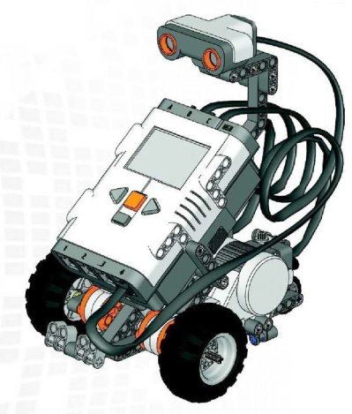
Let’s Build and Code!
Now it’s your turn!
Build a simple robot
and write your first
program using NXT
blocks and software!

